Slide 1
S8237
Autism Spectrum Disorders:
Introduction, Implications and technology
By Qazi Fazli Azeem
South Asian self advocate for the Autism Spectrum
Room 5-217 (Class 5:05 pm - 5:55 pm)
start 5:10 pm
end 5:50 pm
Notes:
My name is qazi fazli azeem.. This in an introductory and interactive class about Autism spectrum disorders, the fastest growing disorder in the world.

Slide 2
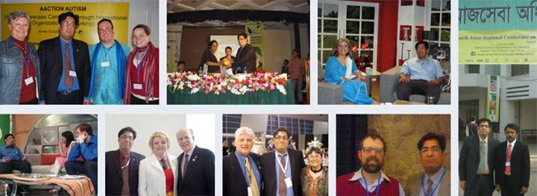
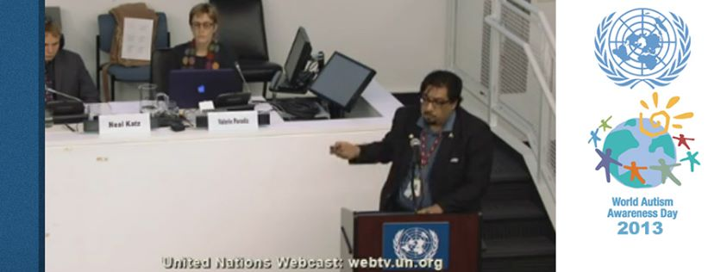
My presentation at the UN is at (1:18:54) http://webtv.un.org/watch/panel-3-world-autism-awareness-day-general-assembly-resolution-62139-ares62139/2272970738001/
Notes:
I am here through the US State Department's Fulbright Scholarship, for my graduate design degree. I am also a visiting researcher at the MIT Media Lab. I the South Asian self advocate for the Autism Spectrum since my autism awareness work started in 2006. I have presented at Autism Conferences & workshops in Pakistan (2006-2012), India (2008), Qatar (2008), UK (2008) and Bangladesh (2009). I spoke at a panel at the United Nations in NY on World Autism Awareness Day 2013. My interview was published in the 2010 book by Adam Feinstein (UK) "A History of Autism: conversations with the pioneers" and my Art has been featured in the 2010-2011 "Art of Autism" books in the US by Debbie Hosseini. My essays on mentoring youth with Autism spectrum disorders have been published in the Feb 2014 book "Been There. DoneThat. Try This! - An Aspie's Guide to Life on Earth" by Jessica Kingsley publishers UK.

Slide 3
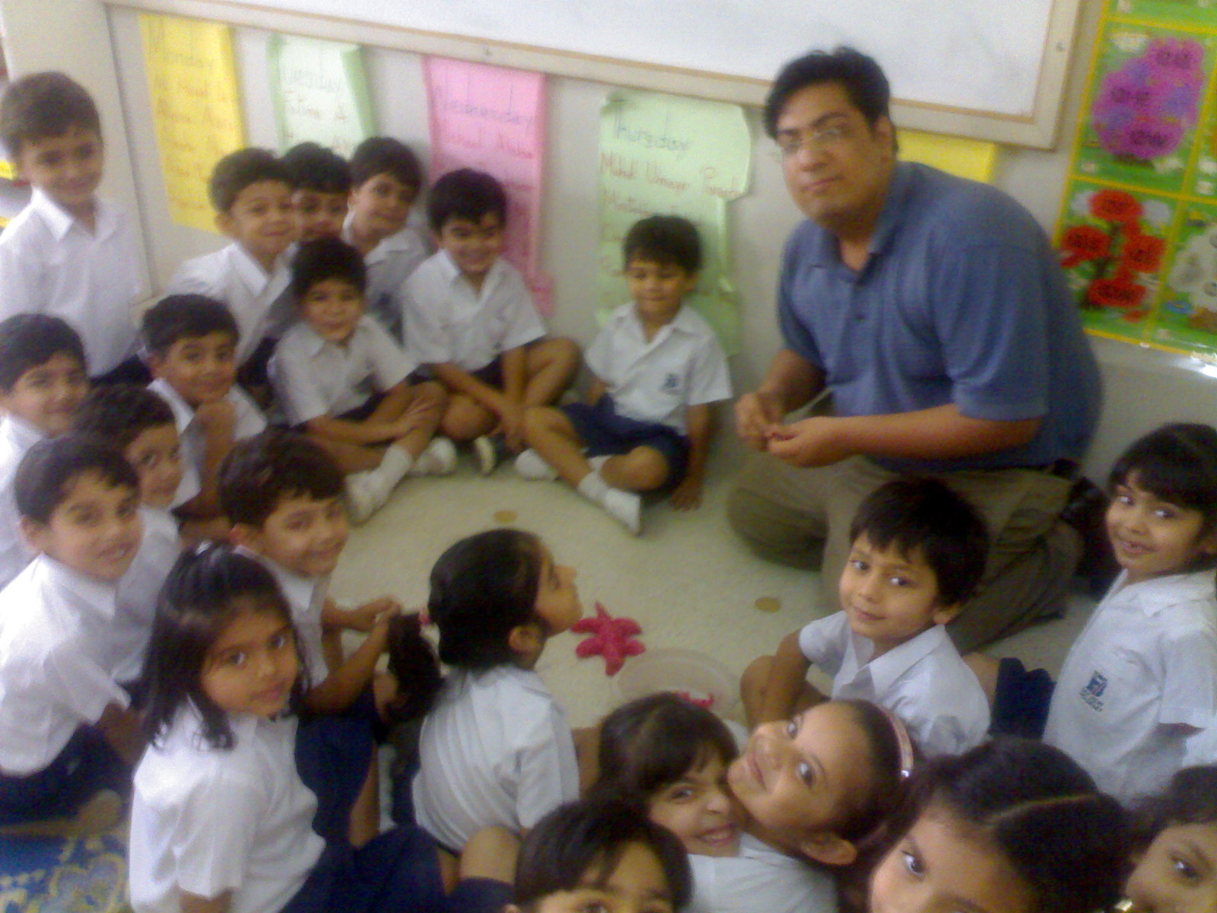

Slide 4
WHAT IS AUTISM?
Very complex, often baffling developmental disability
First described by Leo Kanner in 1943 as early infantile autism
“Auto” – children are “locked within themselves.”
For next 30 years, considered to be an emotional disturbance
Very likely neurological in origin – not emotional
No known racial, ethnic, or social boundaries
No relation to family income, lifestyle

Slide 5
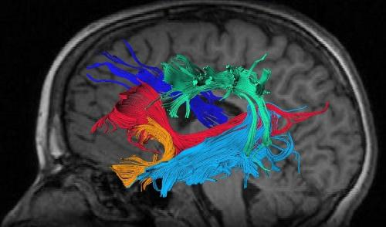
Autism
A spectrum of neuropsychiatric disorders, with limitations in
social interaction, communication, and unusual
and repetitive behavior.
“If you’ve seen one child with autism, you’ve seen one child with autism.”
-Brenda Smith-Myles

Slide 6
Autism is a developmental disorder
Like these disorders:
Cerebral palsy, Down’s syndrome, Learning disabilities and ADHD (Attention deficient hyperactive disorder)
People on the Autism spectrum are born with it. Early intervention, educational support and help can lead to independence and better outcomes later in life.
There are no medical tests for Autism, only behavior tests.

Slide 7
Developmental Milestones
What behavior is this child displaying?

Slide 8
Echolalia
Common in very young children (Age 3)
Immediate or delayed (even years)
Is there communicative intent with echolalia?

Slide 9
What causes Autism?
Good agreement in general that autism is caused by abnormalities in brain development, neurochemistry, and genetic factors

Slide 10
How is Autism Diagnosed?
No definitive medical test
Team uses interviews, observation, and specific checklists developed for this purpose.
Team might include neurologist, psychologist, developmental pediatrician, speech/language therapist, learning consultant, etc.
Must rule out MR, hearing impairment, behavior disorders, or eccentric habits

Slide 11
Turn the picture 90 degrees

Slide 13
1 in 88 children
Notes:
About 1 in 88 children has been identified with an autism spectrum disorder (ASD)

Slide 14
Diagnostic and Statistical Manual of
Mental Disorders, 5th Edition (DSM-5)
Autism spectrum disorders
Includes Autism, Asperger syndrome, PDD-NOS, and child disintegrative disorder (CDD)
Concentrates on required features
Social/communication issues
Limited, repeating behaviors, interests
Sensory issues

Slide 15
Early Symptoms in toddlers

Slide 16
Early Symptoms in toddlers

Slide 17
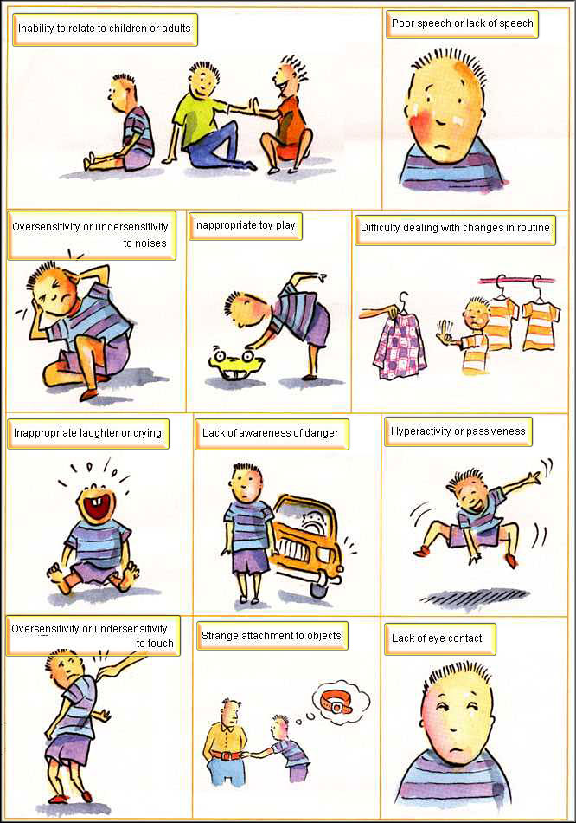
Common Symptoms of Autism in Children

Slide 18
Common Symptoms of Autism in Children
Common Symptoms of Autism in Children

Slide 19
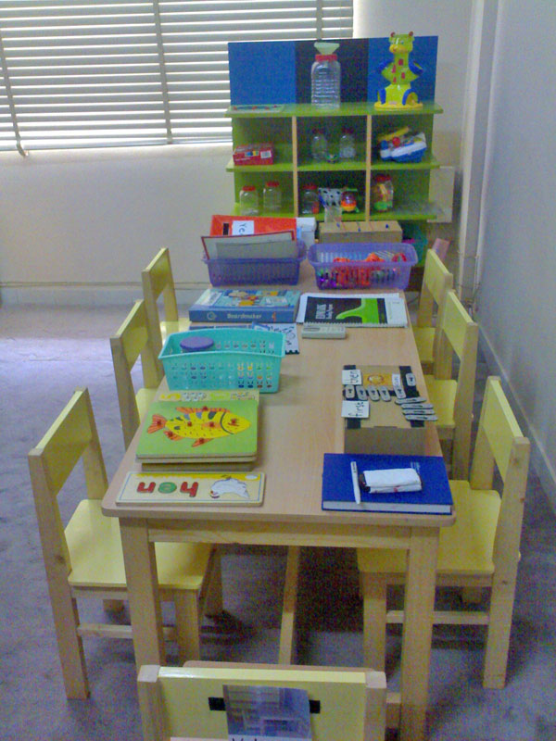
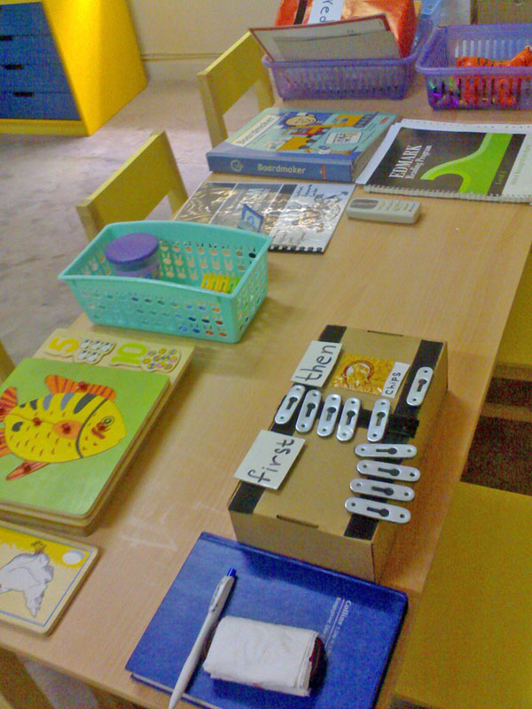

Slide 20
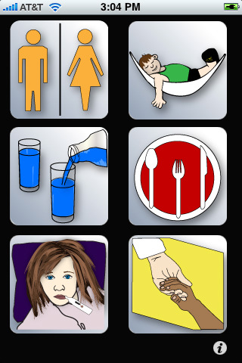
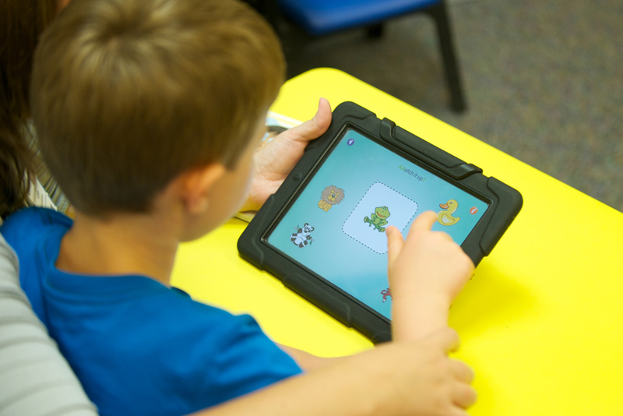
Educating children with Autism
Treatment and Education of Autistic and Related Communication Handicapped Children (TEACHH) and PECS (Picture exchange communication system)

Slide 21
Structured Teaching
Considers a student’s special interests
Relies on data to make or change programming
Increases independent functioning in many environments

Slide 22
Visual Supports
Things you can make to address student needs
Schedules
Calendars
Choice Boards
Rule Charts
Lists
Instructions
Behavior clues

Slide 23
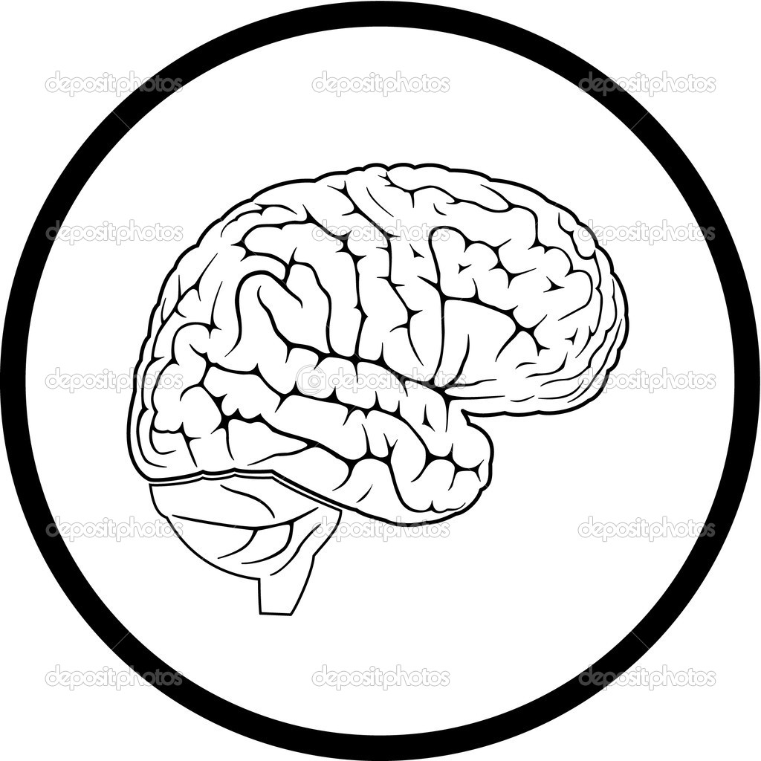
Autism and the Brain
Areas of Possible Difficulty Functions
Prefrontal Cerebral Cortex Social thinking
Hypothalamus Attachment behaviors
Amygdala Social orientation,
emotional learning
Fusiform Gyrus Face recognition
Middle Temporal Gyrus Recognition facial
Expression
Pulvinar Emotional relevance

Slide 24
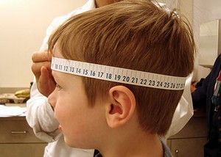
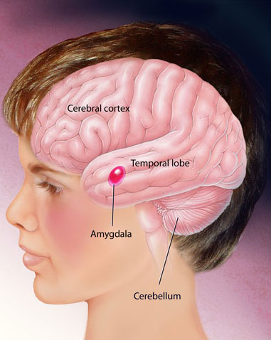
Macrocephaly: 10-20% larger brain size
Larger Amygdala
Key role in the processing of emotions. This brain structure is linked to both fear responses and pleasure as well as anxiety.

Slide 25
CAT
Notes:
As an example this is a photo of a cat

Slide 26
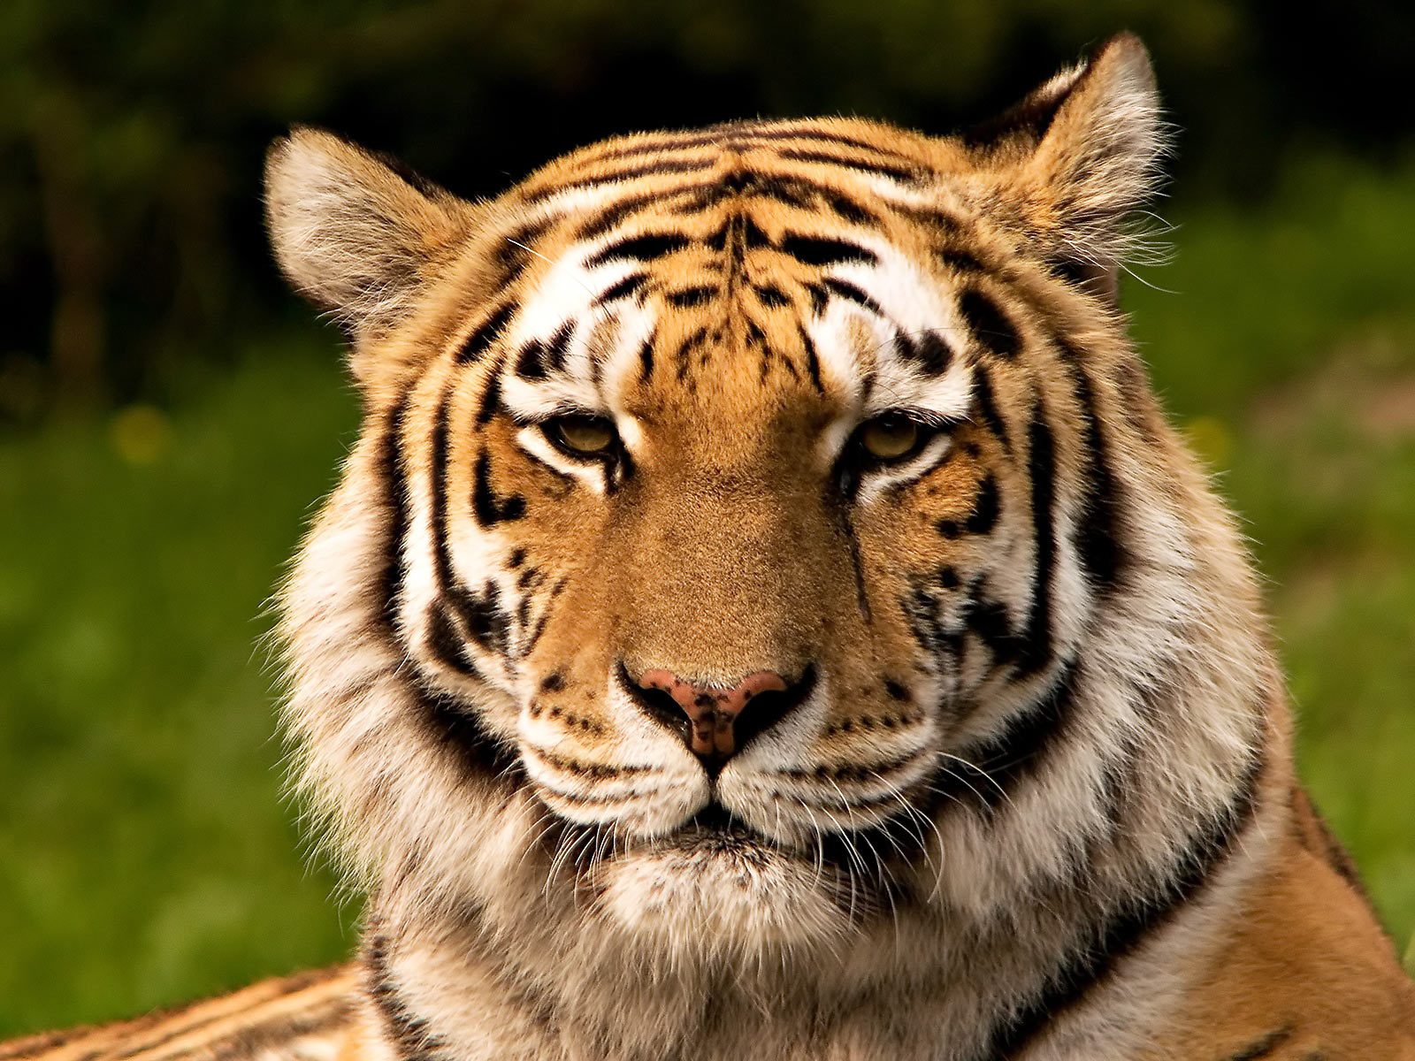
TIGER
Notes:
And this is a tiger

Slide 27
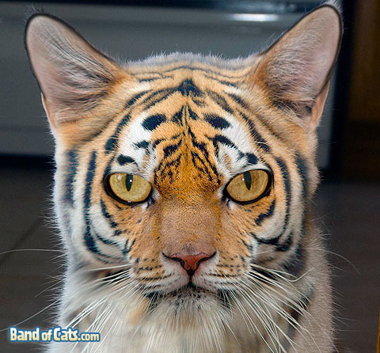
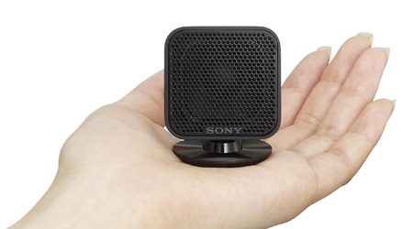
Hypo (under)
Sensitive
Normal
Hyper (over)
Sensitive
Sensory overload.
Notes:
When people on the autism spectrum see something or hear something, they may be hyper or hypo sensitive. A larger Amygdala causes increase in fear, in response to what they hear and see. This Is called sensory overload.

Slide 28
Sensory integration therapy
sound, lights, touch

Slide 29
Notes:
Auditory Desensitization
Persons on the autism spectrum often report hypersensitivity to sound. Efforts have been made to manage this condition, but there is wide room for improvement. One approach - exposure therapy – has promise, and studies show that it can help some individuals overcome sound sensitivities.
The game depicted above was designed to help an individual overcome extreme sensitivity to the sound of people coughing. The volume of the sound effect increases rapidly within the short span of this video clip. However, in the actual intervention, this sound would start at an extremely low volume and would increase in a slow, hierarchical fashion, over the course of 1-3 weeks.

Slide 30
Interest
based
learning
Notes:
Special Interests
Individuals diagnosed with autism spectrum disorder (ASD) often have intense, focused interests. These interests, when harnessed properly, can help motivate an individual to persist in a task that might otherwise be too challenging or bothersome. For example, past research has shown that embedding focused interests into educational curricula can increase task adherence and task performance in individuals with ASD. However, providing this degree of customization is often time-consuming and costly and, in the case of computer-mediated interventions, high-level computer-programming skills are often required. We have recently designed new software to solve this problem. Specifically, we have built an algorithm that will:
(1) retrieve user-specified images from the Yahoo database;
(2) strip them of their background; and
(3) embed them seamlessly into Flash-based computer programs.

Slide 31
Emotions
Notes:
When autistic children get stressed they often don’t show it. Instead, their tension might build until they have a meltdown, which can result in aggression toward others and even self-injury. Since autistic children have a difficult time expressing or even understanding their emotions, teachers and caregivers can have a difficult time anticipating and preventing meltdowns.

Slide 32
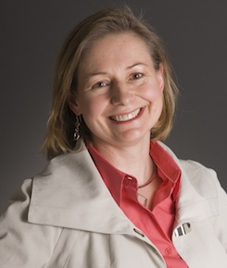
Professor Rosalind W. Picard
Director
Affective Computing Research Group
MIT Media Lab
Notes:
This is Professor Rosalind W. Picard of the MIT Media Lab. She is also a co-founder of Affectiva, a company that makes wearable technology to help measure and communicate emotion, particularly for people on the Autism spectrum

Slide 33
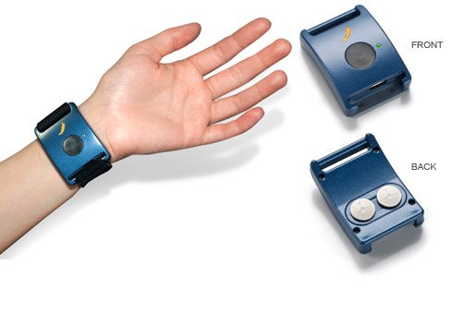
Q Sensor
Notes:
The way this wearable Q sensor works is by detecting and recording signs of stress and excitement in the skin, by measuring slight electrical changes. This process is called electro-dermal activity (EDA). The curve-shaped Q Sensor is designed to wear on the wrist, so it is comfortable to wear all day at work, play, or sleep. This makes it ideal for long-term measurement in clinical and therapeutic research.

Slide 34
What is Electrodermal Activity (EDA
Notes:
Electrodermal activity refers to electrical changes measured at the surface of the skin that arise when the skin receives signals from the brain. For most people, if your mood or emotions change, you are tired from thinking or walking, your brain sends signals to the skin to increase the level of sweating. You may not feel any sweat on the surface of the skin, but the electrical conductance increases due to salt and water in the sweat.

Slide 35
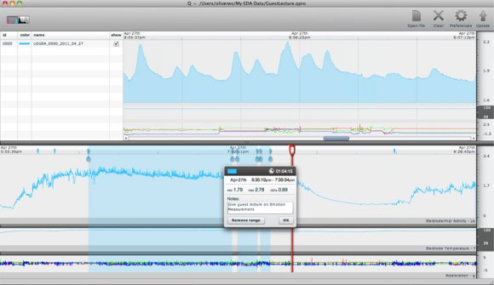
Notes:
The Affectiva sensor tracks stress and other measures in children with autism, wirelessly transmitting the data to a computer. The recorded skin activity can be mapped and seen on screen, based on the time of day it was recorded. This can help find out if certain events were stressful or relaxing, leading to better management of the environment and awareness of emotions.

Slide 36
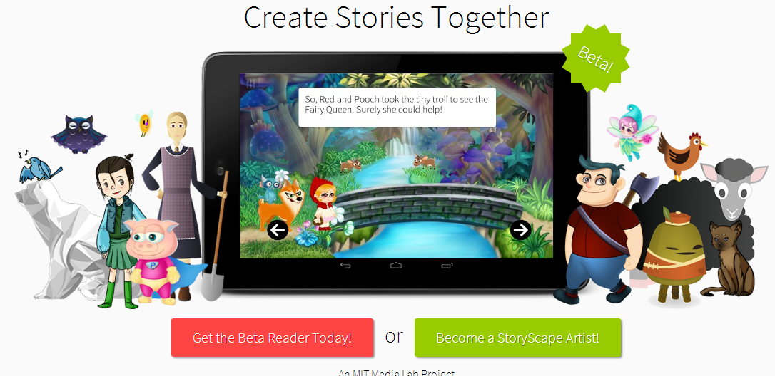
Social Stories
http://storyscape.io
Notes:
StoryScape is a social illustrated app. The StoryScape platform is being developed to allow for easy creation of highly interactive and customizable stories. In addition, the platform will allow a community of content creators to easily share, collaborate, and remix each others' works. Experimental goals of StoryScape include its use with children diagnosed with autism who are minimally verbal or non-verbal. You can test it out at http://storyscape.io/

Slide 37
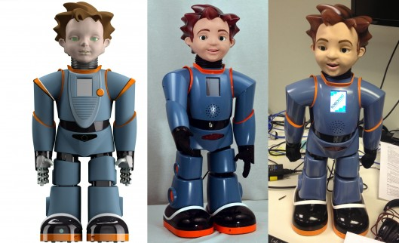
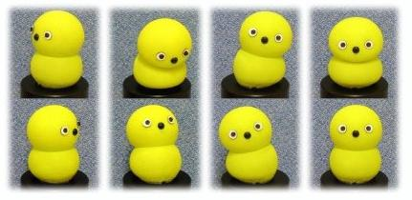
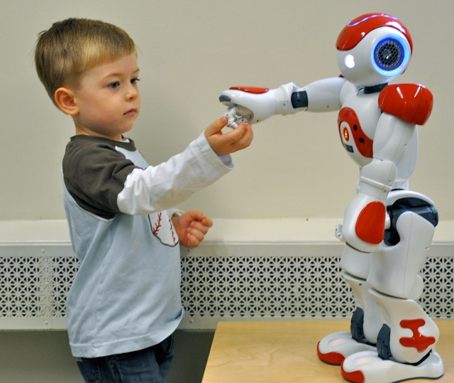
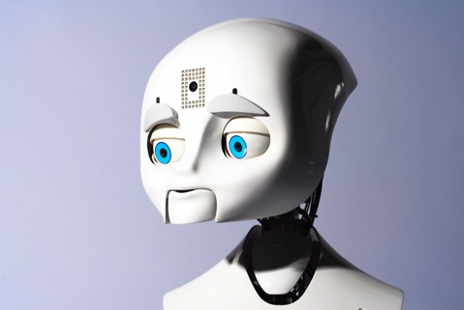
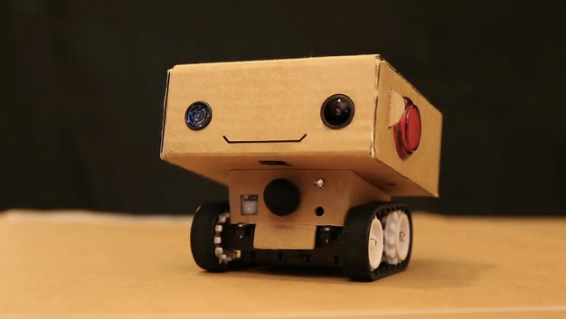
Robots
Notes:
There is a lot of current research with robots, being used to teach children on the Autism spectrum, through prompts, voice interactions, imitated playing as well as turn taking.

Slide 38
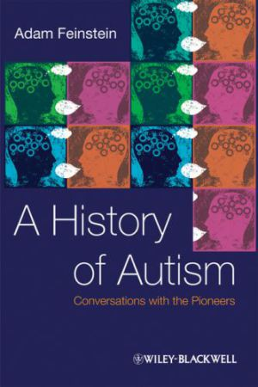
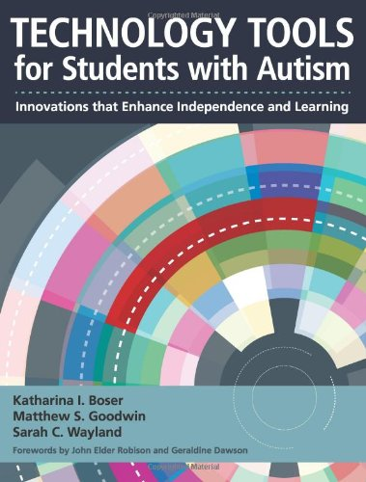
Further reading

Slide 39
The Future?
In general trend has been towards greater improvement
Better adult outcomes
More individuals with language
Higher levels of IQ
Problems do remain, difficulties understanding ‘normal’ ‘cure’
Career possibilities to help people on the Autism spectrum: Game Designers, Neuroscientists, Special Educators, Researchers (psychology),

